Slide 1
PowerShell Prompts: From Basic to Baller
Thomas Rayner
Sr. Security Service Engineer
Microsoft

Slide 2




Obligatory Bio Slide
I work at Microsoft on a pretty cool team
I used to work at some other cool places doing cool things, used to be an MVP
You can find me all over the place
@MrThomasRayner
thomasrayner.ca
github.com/thomasrayner
PowerShell Discord/Slack
Join: j.mp/psdiscord or j.mp/psslack
pluralsight.com/authors/thomas-rayner
Master PowerShell Tricks books
🐺

Slide 3


For real?
Why are you here talking about your PowerShell prompt?
Notes:
The normal prompt is boring
You look at it constantly in the shell
Why not put it to work?
Lots of ways to do cool stuff, this is just what I do

Slide 4
Valuable things to include
History ID
Current date/time
How long the last execution ran
Last exit code
Git information
Nested prompt level
Admin rights
Current username, computername
Folder name
Drive name
PS session information
IoT device information
Free disk space
Which of your favorite community members are streaming right now
Laptop battery level
Wifi/VPN status
ASCII art of your cat

Slide 5
Cool things for their own sake
Non-standard characters – interesting fonts
Colors
Sounds
Animations
Please don’t do the last two for your daily driver

Slide 6
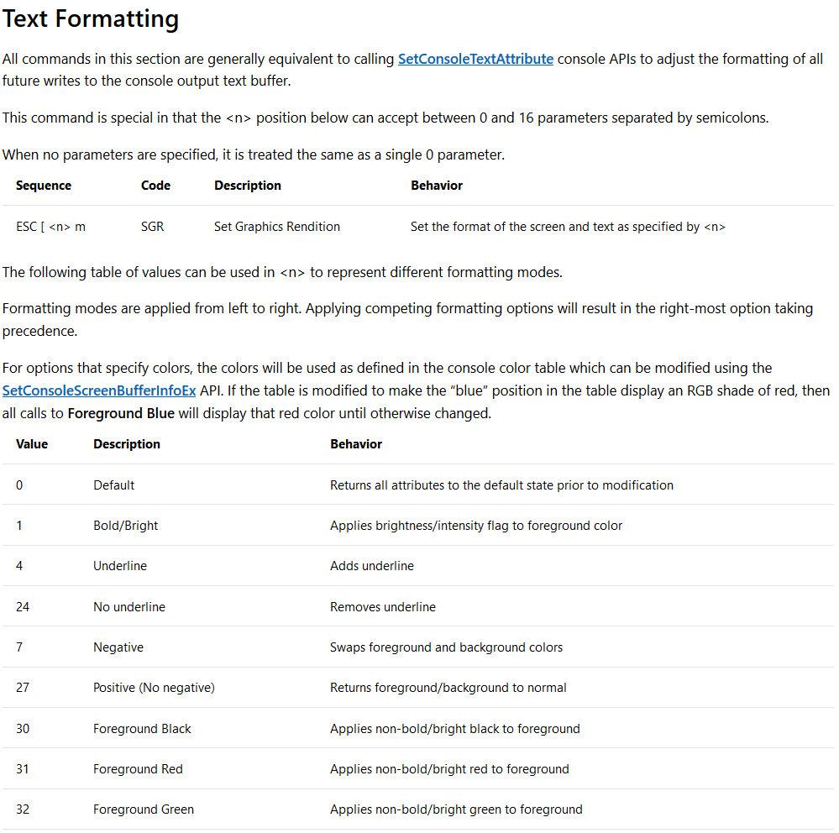
ANSI Escape Sequences
https://docs.microsoft.com/en-us/windows/console/console-virtual-terminal-sequences

Slide 7

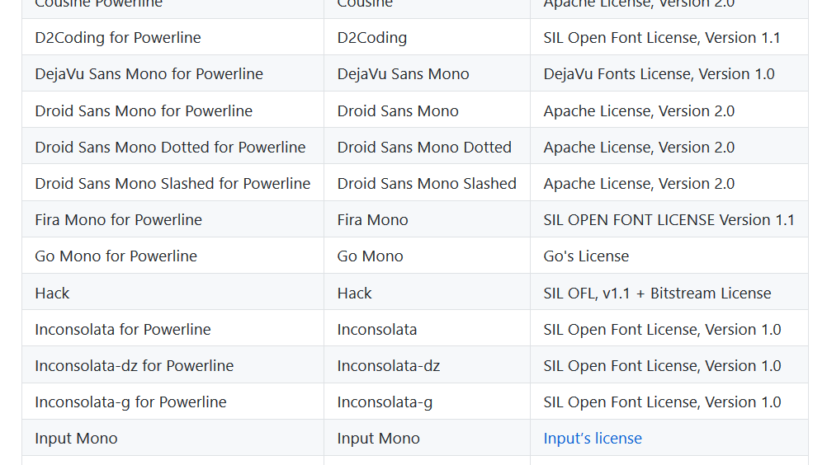
WTF: Weird, Thrilling Fonts
https://github.com/powerline/fonts

Slide 8
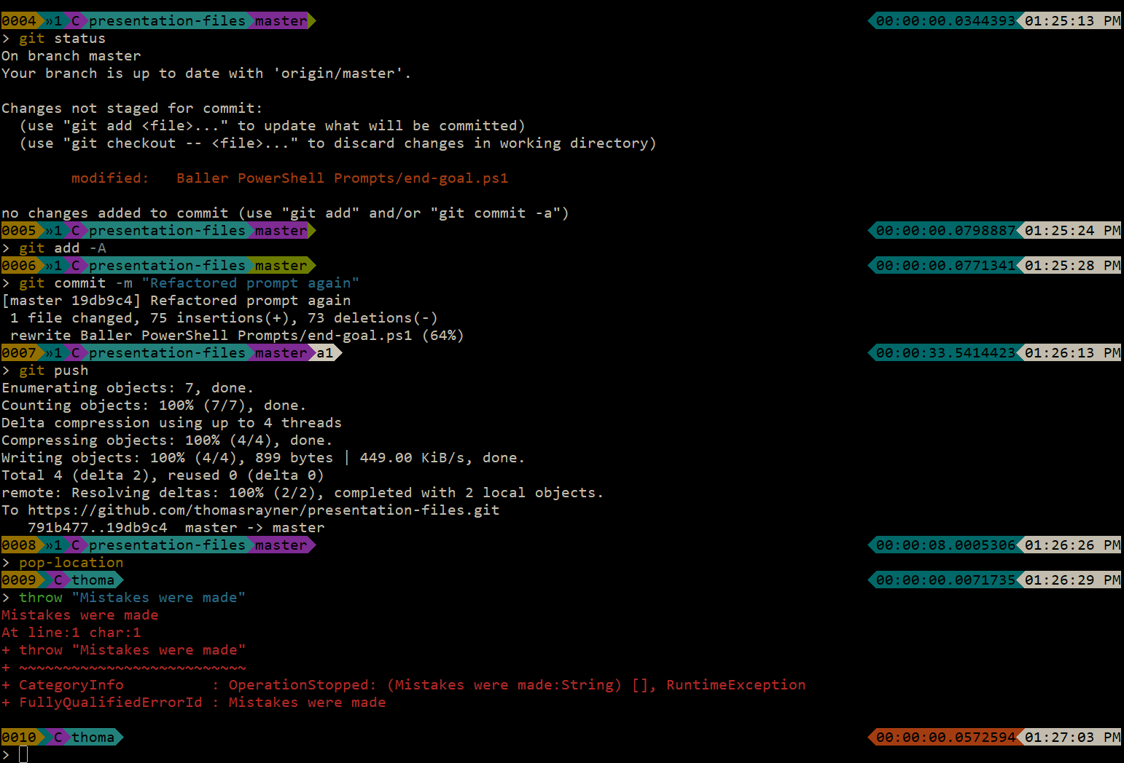
Where am I going with this?
This is my daily driver
Info that’s important to me
Custom colors and chars that I find pleasing

Slide 9

Sweet, now show us the goods

Slide 10
Questions?
@MrThomasRayner
thomasrayner.ca
github.com/thomasrayner
PowerShell Discord/Slack
Join: j.mp/psdiscord or j.mp/psslack
pluralsight.com/authors/thomas-rayner
Master PowerShell Tricks books

